Slide 1

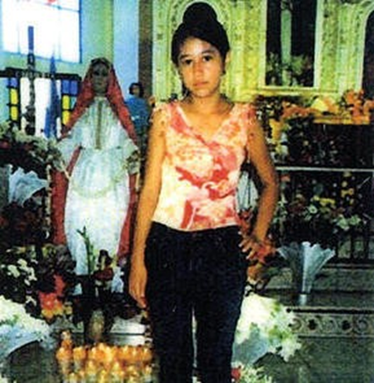

Screening and Assessment for Child Protection in Mixed Migration Flows
U.S. Conference of Catholic Bishops/Migration and Refugee Services-Nathalie Lummert
nlummert@usccb.org
Refugee Resettlement
Community Based Interim Care Arrangements for children in mixed migration arrivals
Assessment and Post Family Reunification Services
Long term integration and resettlement for Unaccompanied Refugee Minors
Training for immigration enforcement officials and child welfare workers
Web-based clearinghouse www.BRYCS.org
Monitoring, evaluation and research
Anti-Trafficking initiatives
Advocacy- Legislation, Assessment trips

Slide 2
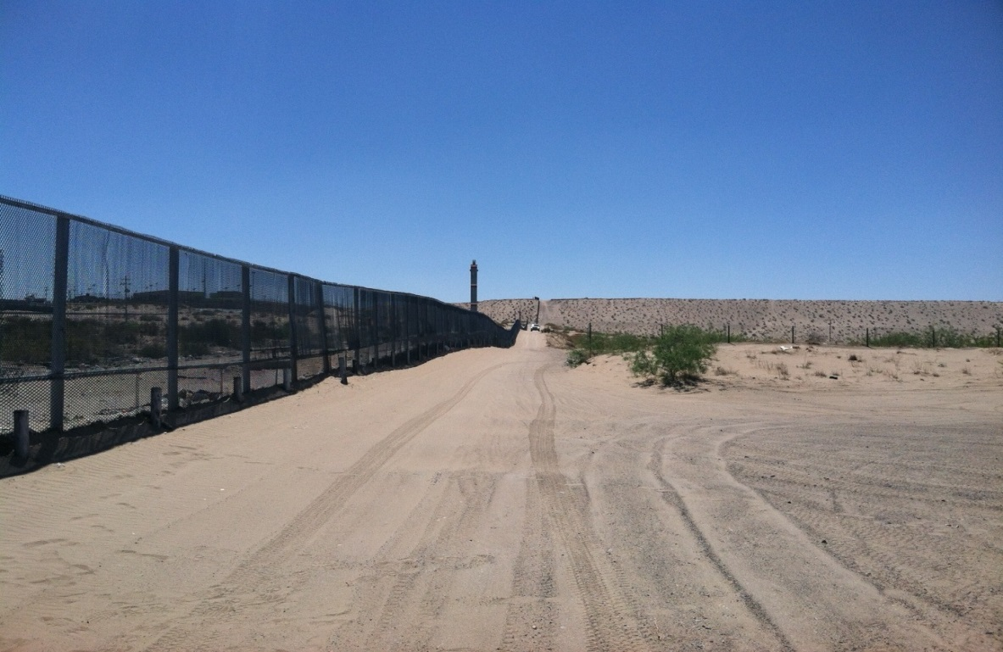
Unaccompanied Children Arriving in the United States
Countries of Origin: Guatemala (34%) El Salvador (27%), Honduras (27%), Mexico (8%), Ecuador (2%) Other (2%) (2012). Different process for Mexican children at the border.
77% Boys and 23% Girls. A majority are 14 - 17 years of age. 12% are below the age of 14. (2012)
Approximate Numbers-7,000 (2011), 12,000 (2012), 23-26,000 (2013)
Division of responsibilities Homeland Security vs. Refugee Resettlement

Slide 3
the U.S.
*
Children have multiple reasons for migration- family separation, violence in home country, looking for work, education, etc.
Unaccompanied children are increasingly telling us that violence in their home countries influenced their migration to the United States. And increasingly, they are experiencing violence en route.
Among Unaccompanied Children in USCCB refugee foster care programs (no family to release to in the U.S.): more than 50 percent of children from Honduras, Guatemala, and El Salvador reported violence in their home country as influencing their journey to the U.S.
Most victims of trafficking are not identified until after they are transferred from border immigration custody. Type of Trafficking- Sex 33%,Labor 44%, and Labor w/ sex exploitation 23% (USCCB Program data)

Slide 4
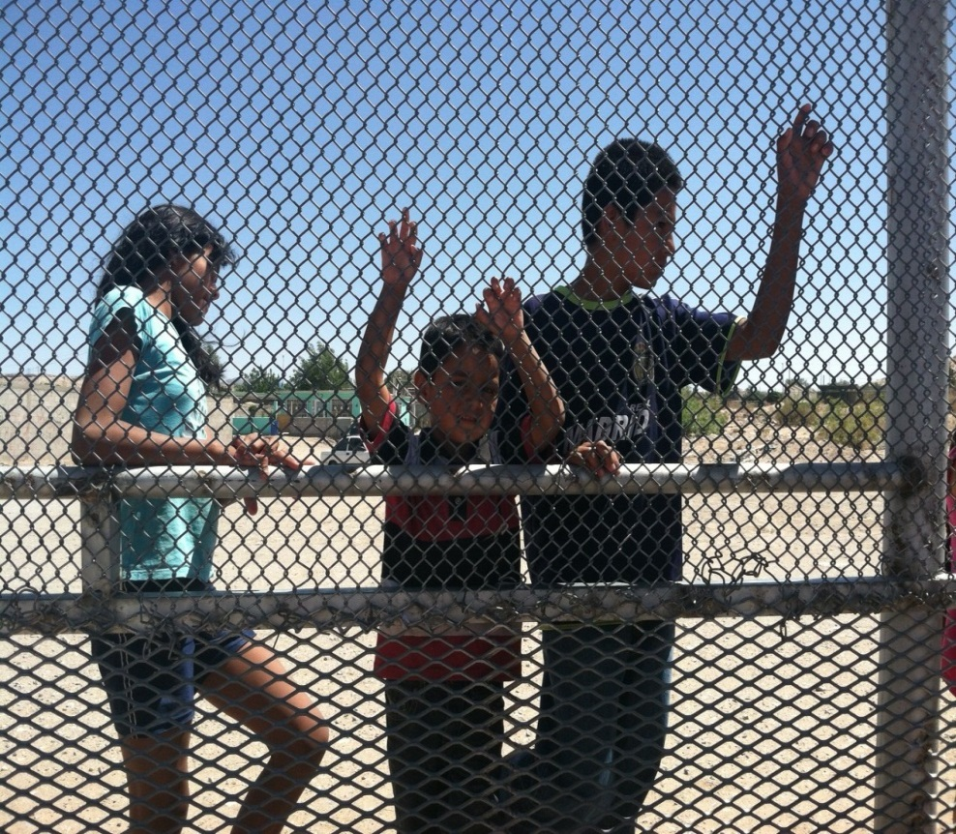
Improving Identification of Children in need of International Protection through Screening and Assessment
Identify the reasons for migration and respond accordingly
Provide child-friendly environment
Identify children vs. adults
Preserve family unity (including separated children)
Provide adequate protection responses, especially in the cases of child trafficking and other vulnerable children
Ensure children’s rights are not ignored within immigration enforcement actions

Slide 5
Protection delivery for children in mixed migration flows
Good practice examples related to screening and assessment
Separating immigration enforcement from child protection functions.
NGO involvement in training of immigration enforcement officials. Training based on practice and data from child welfare professionals.
Advocacy for increased screening at the border for child trafficking, fear of return.
Advocacy for legal screening and representation for all unaccompanied children. Increased protection avenues for most vulnerable.
UNHCR research about motives for unaccompanied child migration. May inform screening and assessment.
Improved assessment tools and staff capacity among care providers. Professionalization.

Slide 6
Screening and Assessment Recommendations
Identification of vulnerable children in mixed migration flows is everyone’s responsibility. To improve the identification of children in need of protection, ensure training by immigration enforcement officials about issues such as child friendly interviewing, children’s rights, human trafficking, and appropriate processing.
Separate immigration enforcement from child care functions as soon as possible to ensure adequate assessment and best interest.
Notes:
Two recommendations
We can’t ignore the role of law enforcement (borders, inspections, sea) in the identification of vulnerable children. First recommend.
2nd. Decreases detention of children, increases access by child welfare professionals and legal representation, and proper assessment of children.

